Slide 1
MDU Sales Training
Salesforce: Day-to-Day for the MDU Team
Ubiquity • MDU Sales

Slide 2
SECTION
Agenda
Eleven sections, roughly in the order you will use them.
1. Why we moved to Salesforce
2. Logging in and getting around
3. How the data fits together
4. Opportunity stages
5. Daily workflows
6. Agreements
7. The MDU Tracker
8. Reports and dashboards
9. How SiteTracker fits in
10. Common gotchas and rules
11. What is coming next
MDU Sales Training • Salesforce
Agenda

Slide 3
01
Why we moved to Salesforce
From a list in Monday.com to a system that ties pursuits, people, agreements, and builds together.

Slide 4
SECTION 1
What changes for you
Monday.com was a list. Salesforce is a system.
• One record per property: the Opportunity is the property pursuit. Everything hangs off it.
• Notes are first class: every conversation, decision, and update on the Opportunity.
• Agreements tracked separately: PAL, ROE, EMA, Bulk each get their own record with own status.
• Stages are the source of truth: moving Opps through stages is how leadership sees pipeline.
• Build tracking stays in SiteTracker: the Opp does not track construction.
MDU Sales Training • Salesforce
Section 1

Slide 5
SECTION 1
What was migrated
What was migrated from Monday.com
• 3,229 MDU Opportunities
• 26 Accounts and 128 Contacts
• 1,291 Agreements (status carried over from Monday columns)
• 13,269 historical Notes (every Monday update preserved by author + date)
MDU Sales Training • Salesforce
Section 1

Slide 6
02
Logging in and getting around
Where to log in, how to find the MDU Sales app, and the tabs you will use every day.

Slide 7
SECTION 2
Where to log in
• Lightning URL: https://fun-power-747.lightning.force.com
• Username: your @ubiquitygp.com Salesforce username
• If you cannot log in: Forgot Password on the login page, or ping Cass.
Switching to the MDU Sales app
• Top left, click the App Launcher (nine-dot grid).
• Type "MDU Sales" and pin it. This is the app you live in day to day.
• If you also work Business pursuits, switch to Business Sales from the same launcher.
MDU Sales Training • Salesforce
Section 2

Slide 8
SECTION 2
Tabs you will use
Tabs you will use
Tab | What it is | When to use it
Opportunities | Every property pursuit | Most of your day. Update stage, log notes, manage agreements.
Accounts | Mgmt companies & owner entities | See all properties tied to one company.
Contacts | People (PMs, owners, leasing, HOA, GCs) | Find a person, see what properties they touch.
Agreements | PAL, ROE, EMA, Bulk records | Pipeline view of contracts in flight.
Property Locations | Serviceable properties (address-level) | One Account can have many Locations.
Reports | Saved reports | Pull lists for meetings or standups.
Dashboards | Visual rollups | MDU Sales Dashboard for a snapshot.
MDU Sales Training • Salesforce
Section 2

Slide 9
03
How the data fits together
The Opportunity is the center of the universe. Everything else hangs off it.

Slide 10
SECTION 3
The pieces
The pieces
• Account: property mgmt company or owner entity (Greystar, an LLC).
• Contact: an actual person (PM, Owner, HOA, Leasing, GC, Legal, Broker).
• Opportunity: the property pursuit. One per property. Where your work lives.
• Opportunity Contact: links a Contact to an Opportunity with a Role.
• Agreement: child of the Opportunity. PAL/ROE/EMA/Bulk/etc.
• Property Location: the serviceable property record. Address, units, parcel.
• Property Unit: individual unit inside a Location (passive for MDU).
• SiteTracker Project: build record in the separate construction org.
MDU Sales Training • Salesforce
Section 3

Slide 11
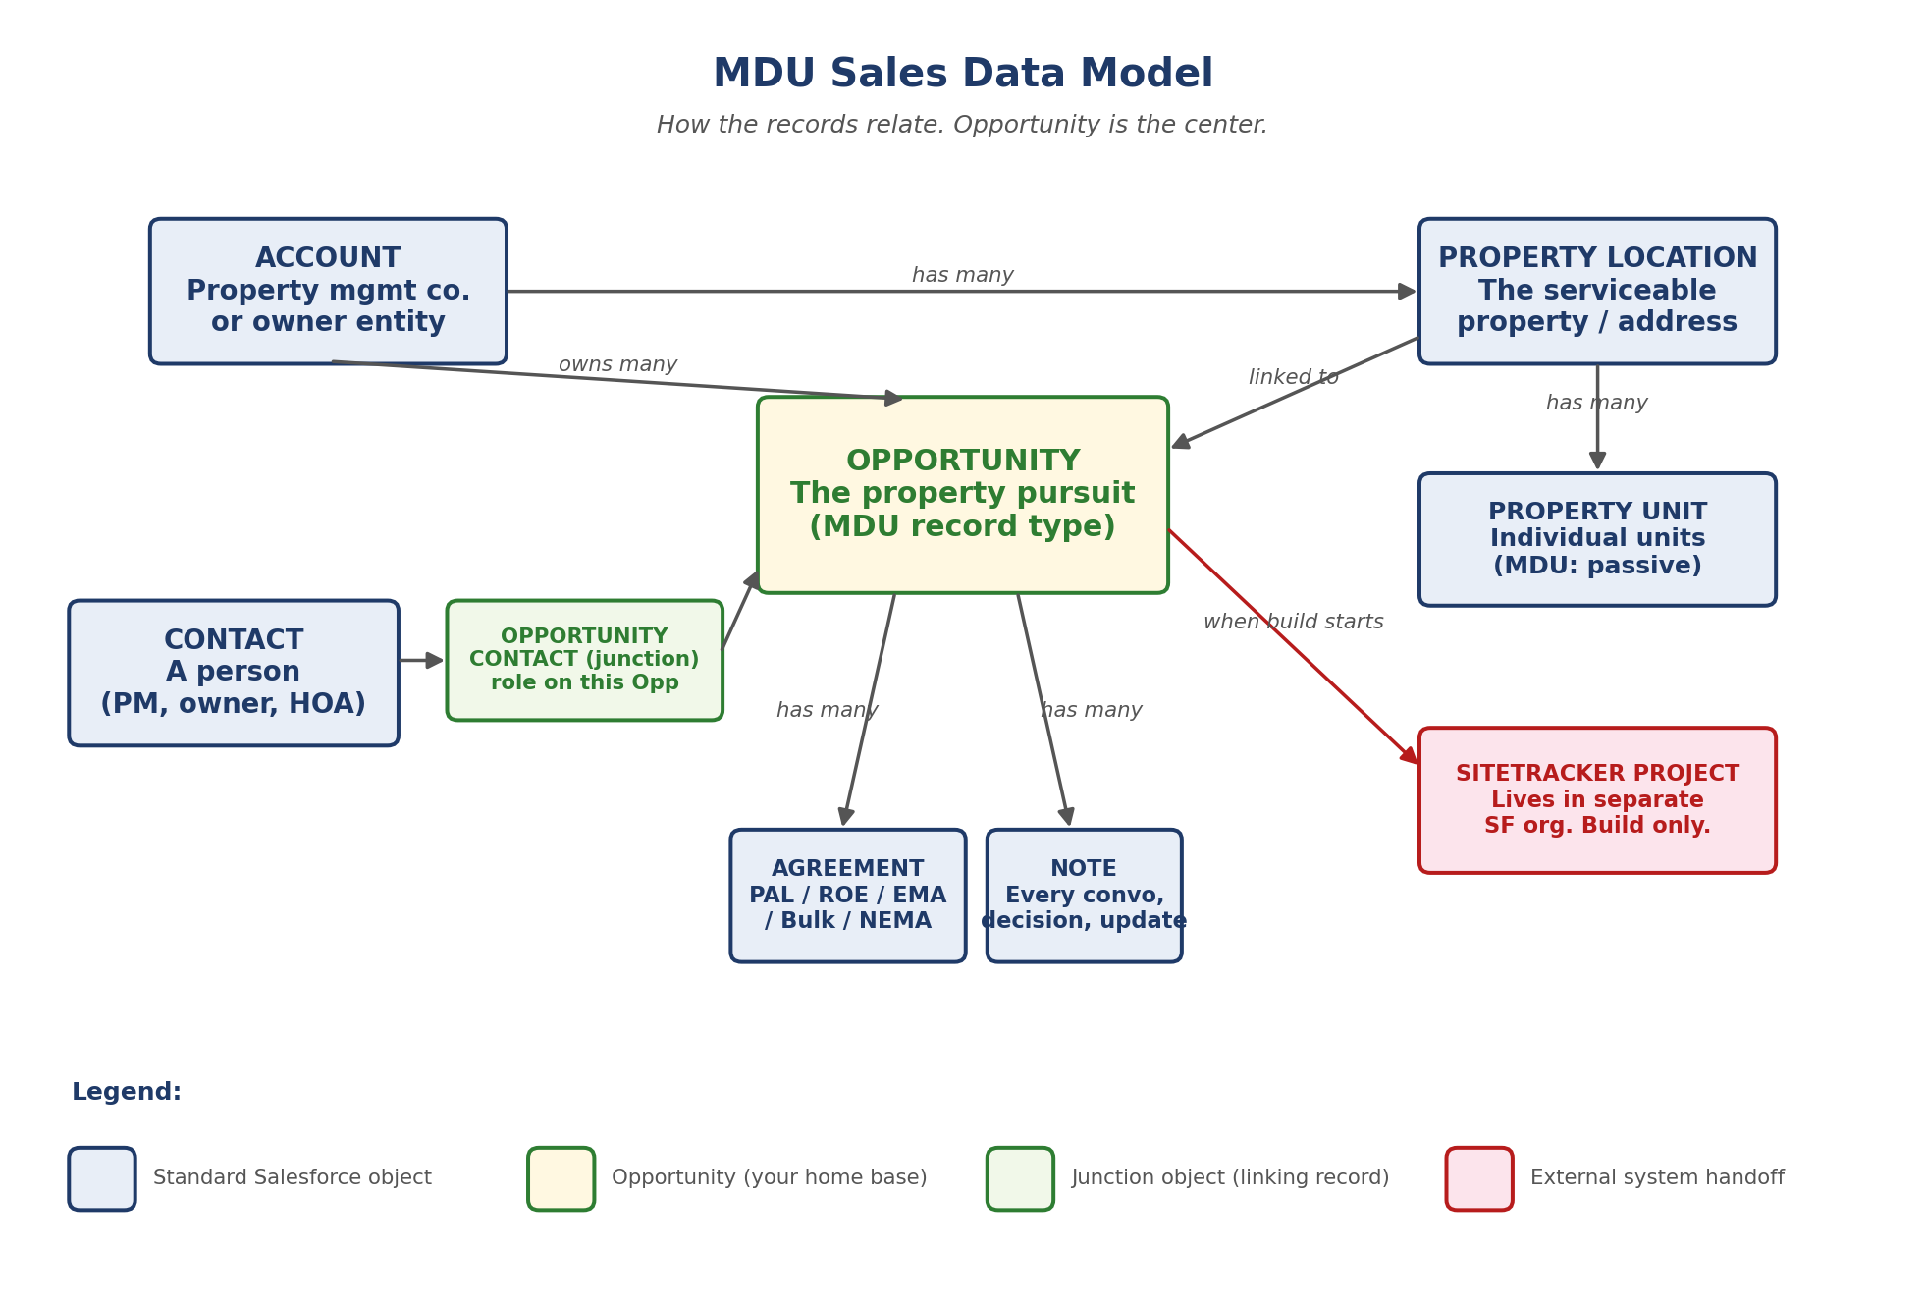
SECTION 3
How the records connect
Account at top, Opportunity in the middle, agreements/notes/SiteTracker fan out from it.
MDU Sales Training • Salesforce
Section 3

Slide 12
SECTION 3
Why a junction object
Why a junction object for Contacts?
A Property Manager often manages dozens of properties. We need that one Contact record connected to every Opportunity she touches, with the role on each. Opportunity Contact is what makes that work.
Practical impact
• Search Contacts before creating. Reuse, do not duplicate.
• On a Contact record, you can see every Opportunity they appear on.
MDU Sales Training • Salesforce
Section 3

Slide 13
04
Opportunity stages
How leadership reads the pipeline. Keeping these honest is the most important habit.

Slide 14
SECTION 4
Stages and what they mean
Stage | Prob. | What it means | What is required
Prospecting | 10% | Property on the radar. Outreach in progress. | Sales Status
Engaged | 30% | In real conversation with the property. | Property contact info
Contract Negotiations | 50% | Terms being discussed. Agreement language going back and forth. | Agreement (Create/Review)
ROE Secured | 50% | Right of Entry locked. | ROE Agreement signed
Under Contract | 100% | PAL signed. SiteTracker takes over. | PAL signed + ST linked
On Hold | 0% | Pursuit paused. | Hold Reason
Closed Lost | 0% | Will not happen. | Loss Reason
MDU Sales Training • Salesforce
Section 4

Slide 15
SECTION 4
Required reasons by stage
Sales Status (used during Prospecting)
• Contact Pending: we do not yet have property contact info.
• Reached Out, Pending Response: outreach made, waiting on a reply.
• Research Completed: background work done, ready to engage.
Hold Reasons
Loss Reasons
• Ownership Change
• Budget or Timing
• Pending Legal Review
• Market Conditions
• Other
• Existing Fiber (most common)
• Existing Contract
• Not Interested
• No Contact Info
• Chose Another Provider
• Unserviceable
• Other
MDU Sales Training • Salesforce
Section 4

Slide 16
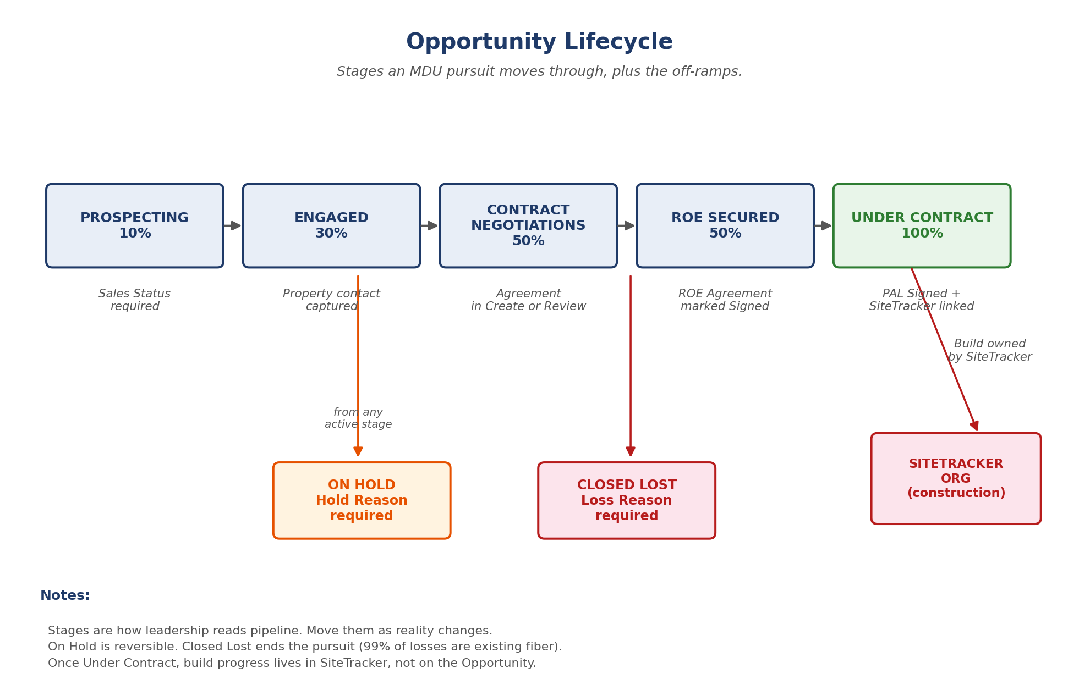
SECTION 4
Stage lifecycle (visual)
Main path along the top. On Hold and Closed Lost are off-ramps from any active stage.
MDU Sales Training • Salesforce
Section 4

Slide 17
05
Daily workflows
Step by step for the seven things you will do most often.

Slide 18
SECTION 5
5.1 Create a new Opportunity
1. Opportunities tab, click New.
2. Pick the MDU record type.
3. Fill basics: Name (use property name), Account, Stage, Projected Close Date.
4. Property Details: Units, Property Type, City, State, Zip (required).
5. If Stage is Prospecting, set a Sales Status.
6. Save. Start logging notes and adding contacts.
Tip
Naming: property name first, units second when ambiguous (e.g. "Olympus Waterford 25").
MDU Sales Training • Salesforce
Section 5

Slide 19
SECTION 5
5.2 Log a note
1. Open the Opportunity.
2. Notes related list (left sidebar), click New.
3. Short title, write the note, save.
4. Newest note shows on top.
Tip
If a teammate opens this Opp in 6 months, the Notes should tell the story.
MDU Sales Training • Salesforce
Section 5

Slide 20
SECTION 5
5.3 Add a Contact
1. Open the Opportunity.
2. Contacts related list (left sidebar), click New.
3. Search for the Contact. Reuse existing records, do not duplicate.
4. Set Role: PM, Owner, Leasing, HOA, GC, Developer, Legal, Broker, Other.
5. Save.
Tip
If the Contact does not exist yet, create it from the Contacts tab first, then link.
MDU Sales Training • Salesforce
Section 5

Slide 21
SECTION 5
5.4 Create an Agreement
1. Open the Opportunity.
2. Agreements related list, click New.
3. Pick Agreement Type (PAL, ROE, EMA, Bulk, NEMA, etc.).
4. Set Status (start at Create).
5. Set Requested Date when it goes out.
6. Set Signer + Signed Date when it lands.
7. Add IronClad ID if you have one.
Tip
PAL is the gateway. Nothing real happens on a property until the PAL is signed.
MDU Sales Training • Salesforce
Section 5

Slide 22
SECTION 5
5.5 Move to Under Contract
1. PAL Agreement Status set to Sign or Completed with Signed Date.
2. On the Opportunity, change Stage to Under Contract.
3. Probability auto-sets to 100%.
4. Build progress now lives in SiteTracker.
Tip
Once Under Contract, the Opp does not change stage again unless something goes wrong.
MDU Sales Training • Salesforce
Section 5

Slide 23
SECTION 5
5.6 Put on Hold
1. Open the Opportunity.
2. Change Stage to On Hold.
3. Set Hold Reason (required).
4. Add a Note: who paused it, when to revisit.
5. Save.
Tip
On Hold is reversible. Use it for real pauses, not stalled outreach.
MDU Sales Training • Salesforce
Section 5

Slide 24
SECTION 5
5.7 Close as Lost
1. Open the Opportunity.
2. Change Stage to Closed Lost.
3. Set Loss Reason (required).
4. Add a Note with detail.
5. Save.
Tip
99% of MDU losses are existing fiber. That is fine. Just record it.
MDU Sales Training • Salesforce
Section 5

Slide 25
06
Agreements
Each Opportunity has its own track of agreements. Most properties end up with several.

Slide 26
SECTION 6
Agreement types
Type | What it does
PAL | Property Access License. Gateway agreement. Required before engineering.
ROE | Right of Entry. Physical access to the property for survey and build.
EMA | Easement / marketing access. Often parallel to PAL.
Bulk | Bulk service agreement when the property is paying for all units.
NEMA | Non-exclusive marketing agreement.
PAL Addendum | Modification to an existing PAL.
MSA Addendum | Modification to a master services agreement.
2nd ISP NEMA | When a second ISP is also marketing on the property.
MDU Sales Training • Salesforce
Section 6

Slide 27
SECTION 6
Status flow + IronClad
Status flow (aligned to IronClad)
• Create: drafting in progress on our side.
• Review: out for internal or counterparty review.
• Sign: signature collection underway.
• Completed: fully executed.
• Archive: completed and filed.
• Paused: stalled, waiting on something external.
• Cancelled: will not happen.
IronClad ID
Populate it when you have it. Going forward, Agreements with no IronClad ID show on a cleanup report. Treat it as the audit trail.
MDU Sales Training • Salesforce
Section 6

Slide 28
07
The MDU Tracker
The single most useful view in the app. Filtered, paginated, summarized.

Slide 29
SECTION 7
Living in the Tracker
What it shows
Filters
• Property name
• Stage
• SiteTracker Build Status
• Owner + RE Assigned
• Projected Close Date
• Summary bar: Opps, Units, completed Agreements
• 50/page + Load More
• Owner: your pipeline or someone else's.
• RE Assigned: TF, JB, RS, etc.
• Stage: MDU stages only.
• Date range: by Projected Close.
How to use it through the week
• Mondays: filter to your Owner, walk Engaged + Contract Negotiations.
• Mid-week: scan On Hold for anything ready to re-engage.
• Fridays: anything closing this month with a stale stage gets a Note + status check.
MDU Sales Training • Salesforce
Section 7

Slide 30
08
Reports and dashboards
Where to look when you need a list, a chart, or a snapshot for leadership.

Slide 31
SECTION 8
Dashboards available to you
MDU Sales Dashboard
Six charts, filterable by Opportunity Owner. Open from the Dashboards tab.
• Opportunities by Stage
• Opportunities by Owner
• Opportunities by State
• Units by Stage
• Stage by Owner Matrix
• SiteTracker Coverage
Campaign Dashboard
When properties are part of a named initiative (e.g. 9-25 MDU ROE Project), they are tagged via Campaign. The Campaign Dashboard shows pipeline progress for just that group.
MDU Sales Training • Salesforce
Section 8

Slide 32
09
How SiteTracker fits in
Build tracking lives somewhere else. Here is how the two connect.

Slide 33
SECTION 9
What you see and where
SiteTracker is a separate Salesforce org used by Engineering. We do not track build milestones on the Opportunity.
What you see in MDU Sales
• SiteTracker Project ID: the linking key. Auto-populated by sync.
• SiteTracker URL: click through to the build record in the SiteTracker org.
• ST Build Status: shown on the Tracker as a virtual column.
• In SiteTracker checkbox: yes/no, whether the Opp is linked.
Rule of thumb
If it is about the sale (status, agreements, contacts, conversations) it goes in MDU Sales. If it is about the build (FDH activation, lit fiber, install schedule) it lives in SiteTracker.
MDU Sales Training • Salesforce
Section 9

Slide 34
SECTION 9
How the sync works
How the sync works
• GitHub Action runs every night at 2am Central, syncing SiteTracker Projects into MDU Sales.
• Match key is property name + Agreement Name. New projects link automatically.
• If a property has no link after construction starts, flag it to Cass.
MDU Sales Training • Salesforce
Section 9

Slide 35
10
Common gotchas and rules
The validation rules and quirks that catch people their first week.

Slide 36
SECTION 10
Validation rules
Validation rules you will hit
• City, State, Zip required: you cannot save without all three. Set them at creation.
• Sales Status required when Prospecting: pick Contact Pending, Reached Out, or Research Completed.
• Hold Reason required when On Hold: pick a reason.
• Loss Reason required when Closed Lost: pick a reason.
• Agreement Name is unique: do not duplicate. If you see a dupe error, search first.
MDU Sales Training • Salesforce
Section 10

Slide 37
SECTION 10
Habits and what to do when stuck
Habits to keep
• Do not edit Close Date. Use Projected Close Date for forecasting.
• Reuse existing Contacts before creating new ones.
• Use Notes for every conversation. Pipeline reviews depend on it.
• Move the Stage when reality changes. Stale stages are worse than empty ones.
If something looks wrong
• Cannot find an Opp? Check Closed Lost and On Hold filters.
• Contact on the wrong Account? Fix the Contact, not the Opp link.
• Missing SiteTracker link on a built property? Send the property name to Cass.
• Validation rule blocking you? Screenshot the error, ping Cass, do not work around it.
MDU Sales Training • Salesforce
Section 10

Slide 38
11
What is coming next
Where this is going over the next few months.

Slide 39
SECTION 11
Coming next
• IronClad sync: agreement status flows automatically once API access lands.
• Monday.com retirement: once the team is comfortable here, Monday.com goes away for MDU.
• ROE & SAQ Excel trackers fold in: become Salesforce reports backed by Agreement records.
• Investor PAL report: a PAL pipeline tile on the MDU home page for fundraising.
• Tracker enhancements: more filters, saved views per user, deeper SiteTracker integration.
MDU Sales Training • Salesforce
Section 11

Slide 40
12
Quick reference
The cheat-sheet you keep at your desk.

Slide 41
SECTION 12
Required fields + escalation
Required when you change Stage
Stage | Required field
Prospecting | Sales Status
On Hold | Hold Reason
Closed Lost | Loss Reason
Under Contract | PAL Agreement marked Signed
Who to ask
• Salesforce questions, validation errors, missing data: Cass
• Agreement language and IronClad: Taylor
• SiteTracker / build status: Engineering team
• Pipeline strategy and stage definitions: your sales lead
MDU Sales Training • Salesforce
Section 12

Slide 42
SECTION 12
Where things live
Where things live
If you want to... | Go to...
See your pipeline at a glance | MDU Sales Dashboard
Walk every active Opp in your name | MDU Tracker, filter by Owner = you
See agreements in flight | Agreements tab, MDU Agreements list view
Find a Property Manager | Contacts tab, search by name
See all properties for a company | Account record, Opportunities related list
Check construction status | SiteTracker URL on the Opportunity
Run a list for a meeting | Reports tab, MDU Sales Reports folder
MDU Sales Training • Salesforce
Section 12

Slide 43
Questions?
Send anything that comes up after the session to Cass.
MDU Sales Training

